Slide 1
Traffic Light Exchange (TLEX) platform
Ready to use
Always available
Secure

Slide 2
TLEX (Traffic Light Exchange) Platform
Connect Traffic Light Controllers to information brokers, automotive industry, governments and ultimately road users
TLC vendor independent
Based on European ETSI standards
Operational in the Netherlands since April 2016
Ready to use
Always available
Secure

Slide 3
Supported use cases
Time to Green / recommended speed realtime available for road users
Priority requests for designated traffic
iTLC’s can realtime optimize their planning based on incoming traffic
Ready to use
Always available
Secure

Slide 4
Ecosystem
Smart Traffic Light
Controllers able to
send and receive data
(C1)
Central platform
HUB to connect
all TLC’s and manage
data exchange
Information brokers
for geofencing and
data enrichment
(C2)
End users
solutions
(C3)
Road users
Ready to use
Always available
Secure

Slide 5
Ecosystem in action
Road users sending and receiving data
with their preferred
solutions
TLEX sending and receiving
aggregrated status
data with brokers
Solutions work
with their preferred
brokers
iTLC’s sending
and receiving
realtime status
data
with TLEX
Ready to use
Always available
Secure

Slide 6
Ecosystem in action
Road users sending and receiving data
with their preferred
solutions
TLEX sending and receiving
aggregrated status
data with brokers
Solutions work
with their preferred
brokers
iTLC’s sending
and receiving
realtime status
data
with TLEX
Ready to use
Always available
Secure

Slide 7
TLEX characteristics
Scalable near infinity
Redundant application architecture with integrated load balancing
Data encryption (TLSv1.2)
Layered authorization model
Session logging and tracking with automated failsafe mechanisms
Secure software design
DDoS attack protection
Monthly pentesting
24x7 support, management and monitoring
Ready to use
Always available
Secure

Slide 8
Phase 1 Netherlands:
1268 iTLC’s
3 Brokers
Phase 1 Netherlands:
+/- 45 million messages per minute
Between TLC’s and road users
(SPAT/MAP/DENM/CAM/SRM /SSM)
Average latency: +/- 8 ms
Ready to use
Always available
Secure

Slide 9
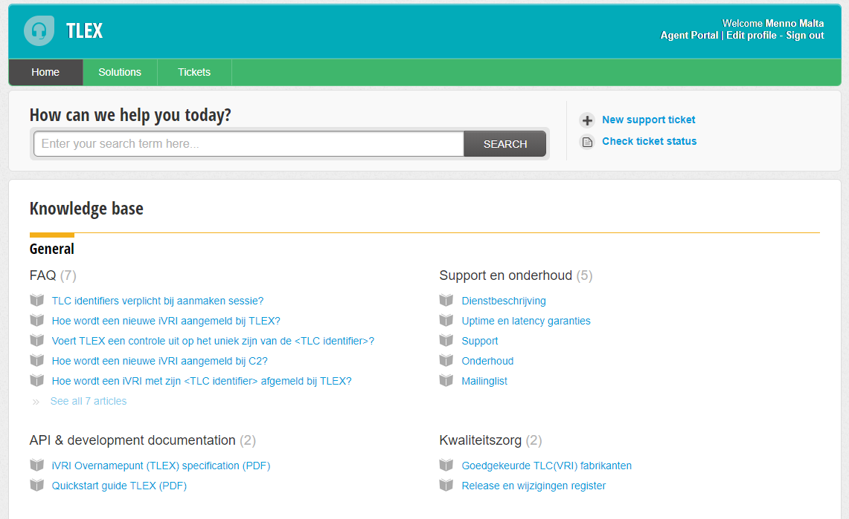
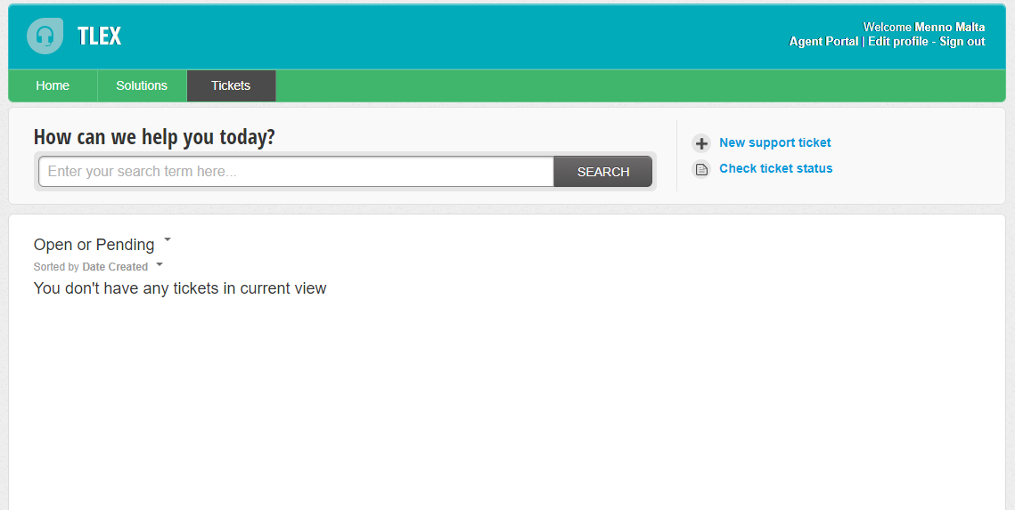
TLEX Documentation and support portal
Ready to use
Always available
Secure

Slide 10
More information?
Please send an e-mail to
mmalta@monotch.com
Ready to use
Always available
Secure

